Slide 1








IMDB MOVIE ANALYSIS
Trainity Project By Vaishakh Menon

Slide 2


Content
Project Description
Approach
Tech-Stack Used
Insights
Result

Slide 3

PROJECT DESCRIPTION

Slide 4

The objective of this project is to conduct a comprehensive analysis of the IMDB movie dataset. The analysis focuses on several key aspects of the dataset, including movie genres, duration, language, directors, and budget. By exploring these factors, we aim to understand their impact on the IMDB scores and financial success of movies

Slide 5
APPROACH

Slide 6


Data Cleaning:
This step involves preprocessing the data to make it suitable for analysis. It includes handling missing values, removing duplicates, converting data types if necessary, and possibly feature engineering.
Data Analysis:
This step we explore the data to understand the relationships between different variables. You might look at the correlation between movie ratings and other factors like genre, director, budget, etc. You might also want to consider the year of release, the actors involved, and other relevant factors.

Slide 7
TECH-STACK USED

Slide 8


Microsoft Powerpoint
Microsoft Excel

Slide 9
INSIGHTS

Slide 10
Movie Genre Analysis
Movie Duration Analysis
Analyze the distribution of movie genres and their impact on the IMDB score.
Analyze the distribution of movie durations and its impact on the IMDB score.
Language Analysis
Examine the distribution of movies based on their language.
Director Analysis
Budget Analysis
Influence of directors on movie ratings.
Explore the relationship between movie budgets and their financial success.

Slide 11
RESULT

Slide 12

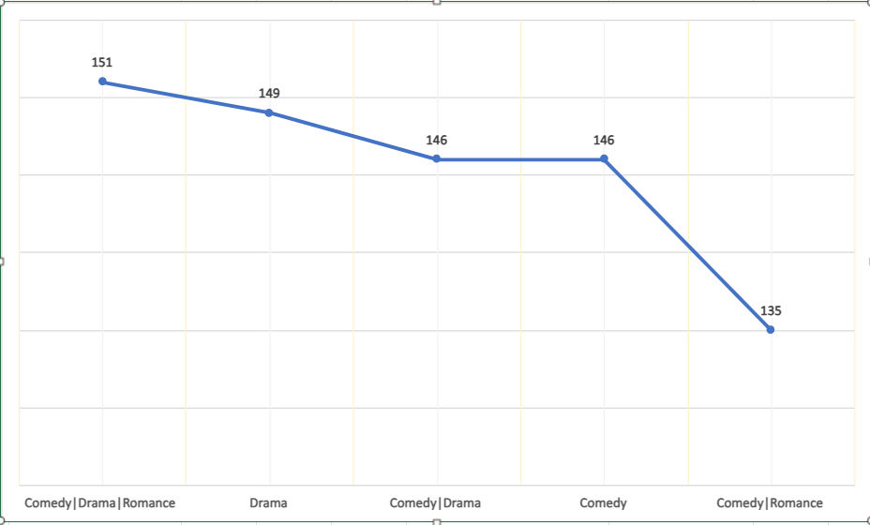

MOVIE GENRE ANALYSIS
Most Common Genre of Movies
Comedy|Drama|Romance
Drama
Comedy|Drama
Comedy
Comedy|Romance

Slide 13
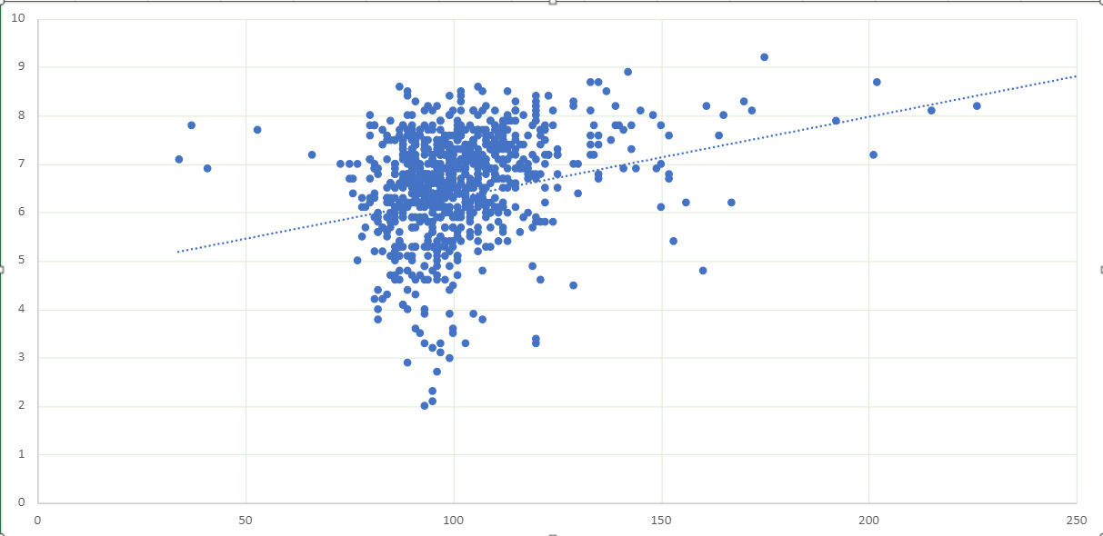
MOVIE DURATION ANALYSIS
We can see that average duration of the movies are 110.03 min.
Movies which have duration in between 200 min and 250 min are getting better IMDB score.

Slide 14


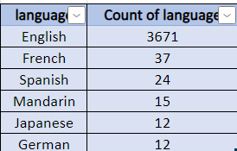
LANGUAGE ANALYSIS
Most of the movies are in English language with on an average 6.4 IMDB score.
French, Spanish, Mandarin, Japanese and German are the top languages with more numbers of movies.

Slide 15

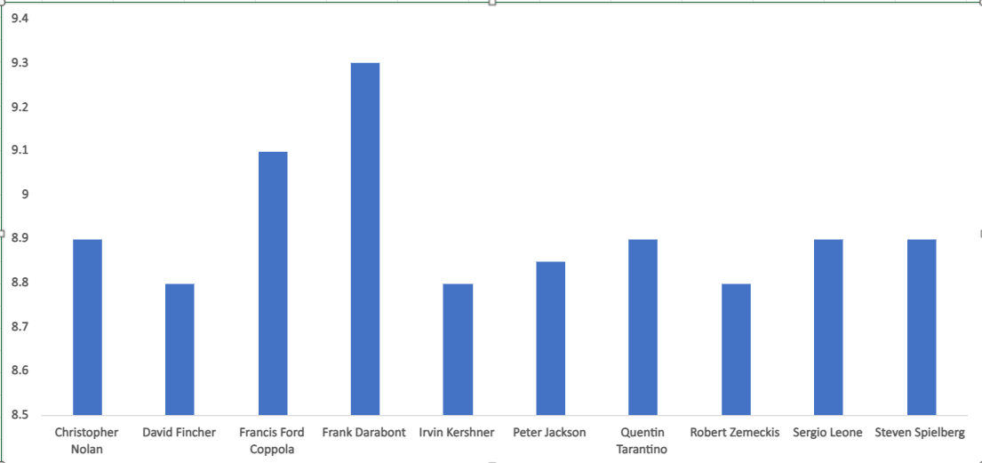
DIRECTOR ANALYSIS
The list of top 10 directors, having highest IMDB score between 9.3 to 8.8.

Slide 16

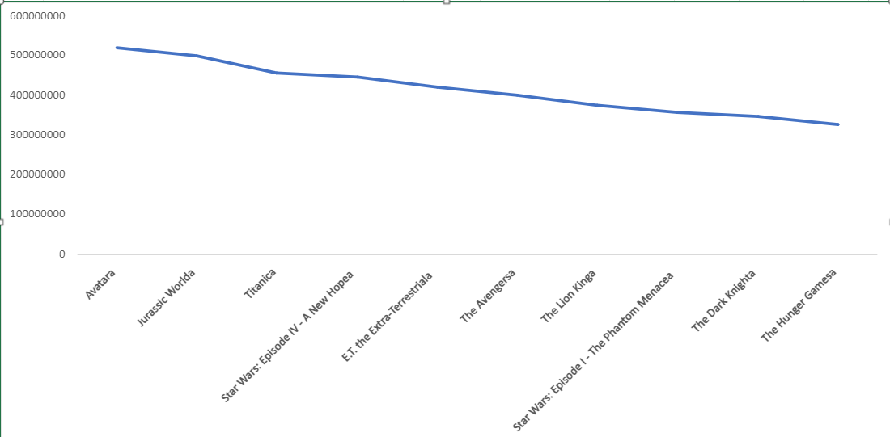
BUDGET ANALYSIS
Top 10 movies which gave profit.
By analysing IMDB dataset we can see that movies have budget of above 200000000 getting more profit.

Slide 17
THANK YOU
Reference := Excel Sheet

